Slide 1
Highway Materials
Lecture - 11
Designed and presented
By
Asst. Prof. Dr. Raquim Nihad Zehawi

Slide 2
Unified Soil Classification System (USCS)
classifies coarse-grained soils on the basis of grain size characteristics and fine-grained soils according to plasticity characteristics.
i.e.
the engineering properties of any coarse-grained soil depend on its particle size distribution
properties for a fine-grained soil depend on its plasticity

Slide 3
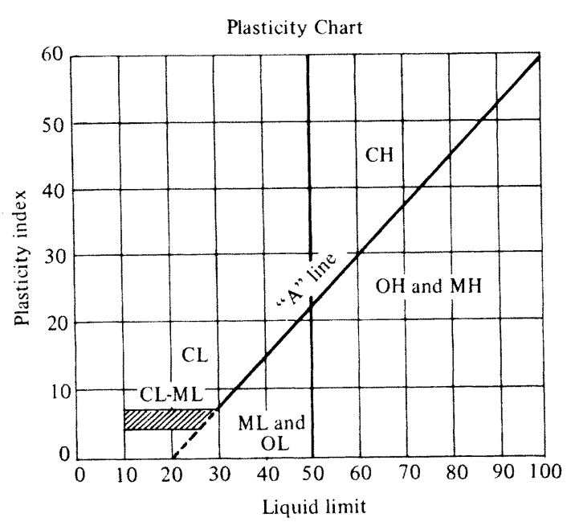
four major groups of materials, consisting of
coarse-grained soils, fine-grained soils, organic soils, and peat.
only the materials that pass the 75 mm (3in) is used for the classification of the sample.
more than 50% larger than 4.75 mm, i.e. retained on No. 4
Gravels (G)
coarse-grained
more than 50 % smaller than 4.75mm i.e. passed through the No. 4 sieve
Soils with more than 50 percent of their particles being retained on the No. 200 sieve
Sands (S)
Clays (C)
fine-grained
CL
CH
Soils with less than 50 percent of their particles retained on the No. 200 sieve
Silt (M)
ML
MH

Slide 5
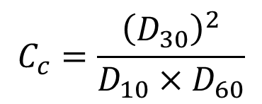
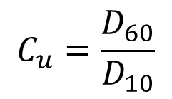
A gravel or sandy soil is described as well graded or poorly graded, depending on the values of two shape parameters known as:
$$C_{u}=\frac{D_{60}}{D_{10}}$$
coefficient of uniformity, Cu
$$C_{c}=\frac{{\left(D_{30}\right)}^{2}}{D_{10}×D_{60}}$$
coefficient of curvature, Cc
Gravels are described as well graded if Cu > 4 and 1 < Cc > 3
Sands are described as well graded if Cu > 6 and 1< Cc > 3

Slide 6
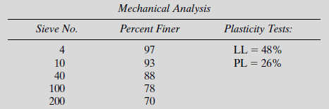
Example 3
Classifying a Soil Sample Using the AASHTO Method
Using the AASHTO method for classifying soils, determine the classification of the soil and state whether this material is suitable in its natural state for use as a subbase material.
Solution
Determining the plasticity index PI = LL – PL = 48% - 26% = 22%
Determining the group index
GI = (F-35) [0.2+ 0.005(LL – 40)]+0.01(F – 15) ( PI -10)
GI = (70 – 35) [0.2+ 0.005(48 – 40)]+0.01(70 – 15) ( 22 -10) = 15
Since the materials passing No.200 sieve = 70% > 35% then the class is either A-4, A-5, A-6, A-7
Since the LL= 48% > 40% then eliminate class A-4, A-6
Since the PI= 22% > 10% then eliminate class A-5
Since (LL – 30) = (48 – 30) = 18% < 30% then the soil class is A-7-6 (15) and therefore it is unsuitable as subbase material in its natural state

Slide 7
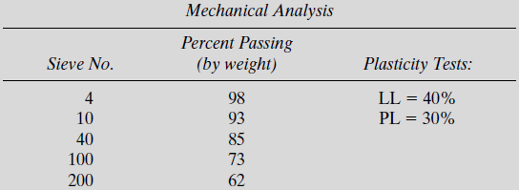
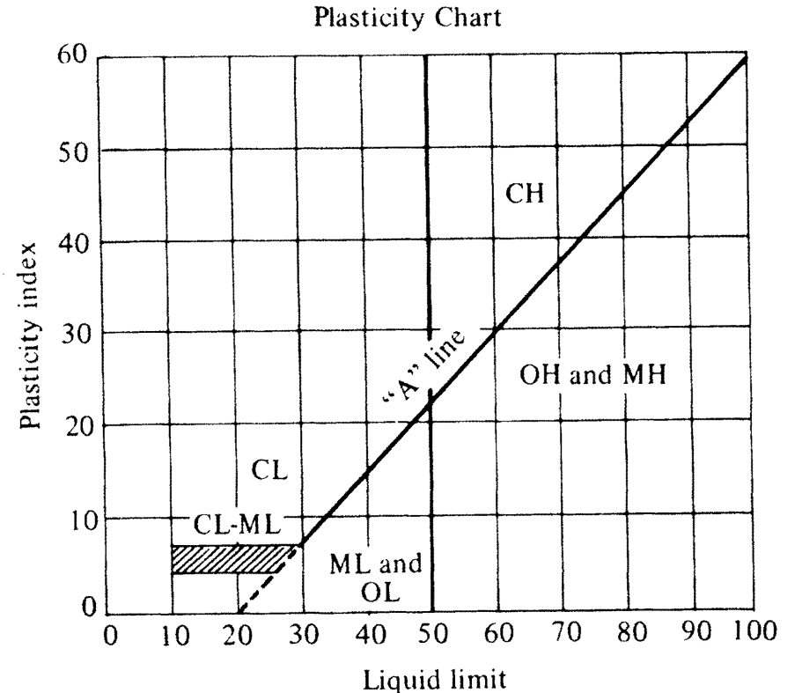
Example 4
Classifying a Soil Sample Using the Unified Soil Classification System
Classify the soil using the USCS and state whether or not it can be used in the natural state as a subbase material.
Solution
Since more than 50% (62%) of the soil passes the No. 200 sieve, the soil is fine grained.
Since PI = 40 -30 = 10; therefore, it is either silt or organic clay
Since the LL is less than 50% (40%); therefore, it is low LL
This soil can be classified as ML or OL
It therefore is not useful as a subbase material

Slide 8
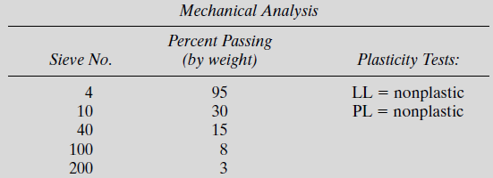
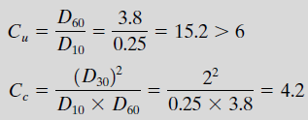
Example 5
Classify the soil using the USCS and state whether or not it can be used as a subbase material.
Solution
Since the pass through the No. 200 = only 3% < 50% then soil is coarse grained
Since the pass through the No. 4 = 95% > 50% the soil is classified as sand
Because the soil is non-plastic, it is necessary to determine its coefficient of uniformity Cu and coefficient of curvature Cc.
From semi log chart
D60 = 3.8 mm
D30 = 2 mm
D10 = 0.25 mm
This sand is not well graded, is classified as SP, and therefore can be used as a subbase material if properly drained and compacted

Slide 9
California Bearing Ratio (CBR) Test
originally developed by the California Division of Highways prior to World War II and was used in the design of some highway pavements
The objective of the test is to determine the relative strength of a soil with respect to crushed rock, which is considered an excellent coarse base material
The test is conducted on samples of soil compacted to required standards and immersed in water for four days, during which time the samples are loaded with a surcharge that simulate the estimated weight of pavement material to be supported by the soil
This test is done by conducting a penetration test on the samples that still carrying the simulated load and using a standard CBR equipment

Slide 10
The CBR is defined as
$BR=\frac{\left(unite load for 0.1 piston penetration in test specimen\right)({lb}/{{in}^{2}})}{(unite load for 0.1 piston penetration in standard crushed rock)({lb}/{{in}^{2}}) }$
The unit load for 0.1 piston in standard crushed rock is usually taken as 1000 lb/in2,
$CBR=\frac{\left(unite load for 0.1 piston penetration in test specimen\right)({lb}/{{in}^{2}})}{1000}$

